Slide 1


The Royal Canadian Legion Centenary
PRE-LAUNCH Projects and plans
100th Anniversary: July 17, 2026
Notes:
Welcome to our short Legion Centenary presentation. We are now in our pre-launch phase. I will highlight some of the programs underway at a national and local level.
While our official birthday is next year, July 17th, we’re starting the celebration now!

Slide 2

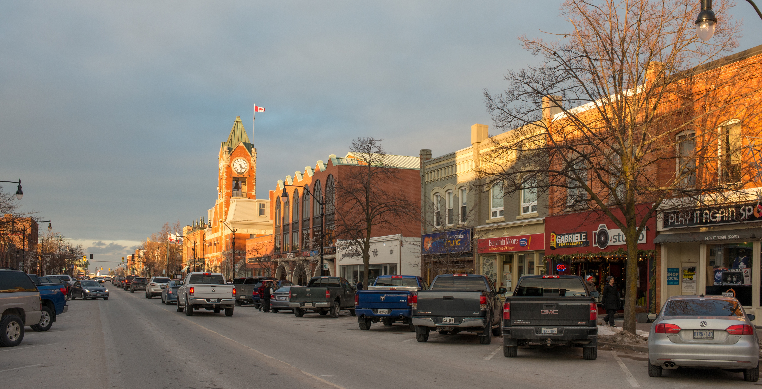

A time to celebrate and educate!
Raise public awareness about new Centenary logo
***Introduce Legion 100 Win Big Giveaway sweepstakes
Look back on accomplishments
Recognize and involve local volunteers
Increase Legion membership
Notes:
Starting on November 25, we launched our new Branch Centenary logo. We also wanted to share that Ford Dealers of Canada are our Official partner during the centenary, and there’s a new national sweepstakes open to all members.
This really is a time to celebrate our birthday and our accomplishments, to raise public awareness and educate Canadians about what we do, to recognize and involve all our local volunteers, and to welcome even more new members, as we celebrate and educate.

Slide 3
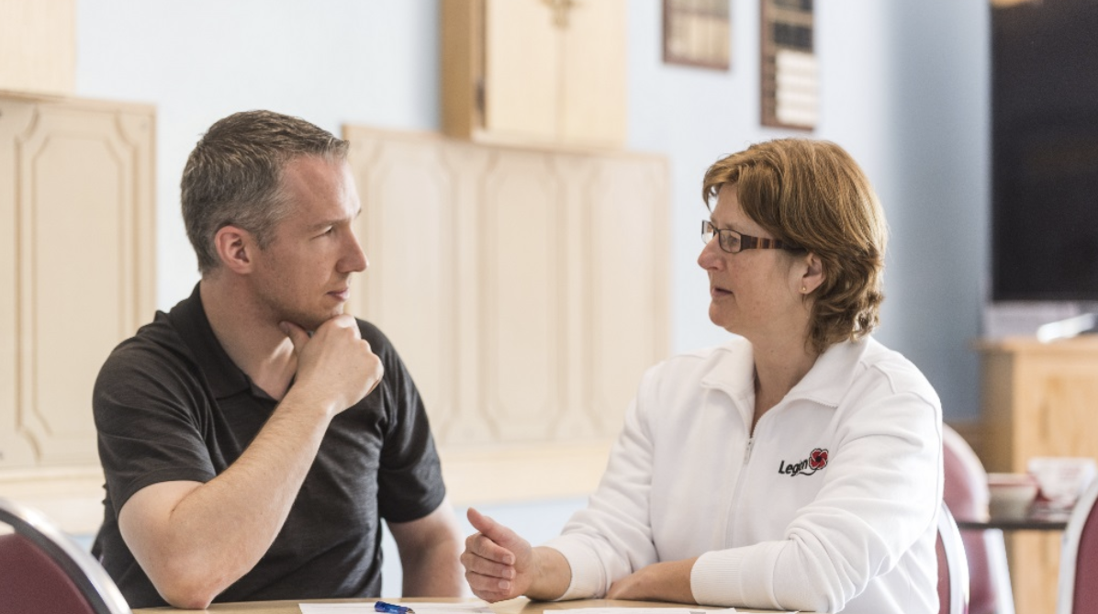
- Formed in 2022 - Representation from all Commands - Considered existing ideas - Presented new ideas - Pre-launch phase
Ford Dealers of Canada: Official Centenary Partner
Legion 100 Win Big Giveaway
Ford F-150 STX grand prize
Centenary Committee
Notes:
A little history. While we have been thinking about this anniversary for some time, Dominion Command struck a Centenary Committee in 2022 to include representation from every Command.
They looked at existing ideas and helped generate additional ideas to present to Dominion Command for consideration.
Ideas are now taking shape … and the Legion is now in its pre-launch phase by sharing its new centenary logo, and its official partnership with Ford Dealers of Canada. As part of the Legion 100 Win Big Giveaway Sweepstakes with Ford Dealers of Canada, a lucky member will win the grand prize of a new Ford F-150 STX truck!

Slide 4

YOUR BRANCH 100th Anniversary Logo
See Anniversary Brand Guidelines p. 11 for information
Notes:
This is our new Branch Centenary logo. It will appear in many places.
You also now have anniversary brand guidelines.

Slide 5
- “Soft Launch” during Legion Week
September 21 - 27, 2025
- Official PRE - Launch after Remembrance Day
November 25, 2025
- Official LAUNCH OF Anniversary year and birthday January, 2026 July 17, 2026
Timelines
Notes:
So what do the timelines look like?
There was a soft launch during Legion Week this year from September 21 to 27. The official pre-launch began on November 25, 2025. Our official anniversary begins in January, with initiatives throughout the year, and we will celebrate our actual birthday on July 17, 2026. More details to come!

Slide 6
- Legion Centenary medal for members - Legion online store merchandise - Dominion Convention Centenary Dinner - Heraldic Crest
Centenary projects
Internal
Notes:
There are many exciting products and events being planned, some of them with a more internal focus.
We now have a Legion Centenary medal for members.
For our pre-launch, we are starting to sell branded Legion online store merchandise like ballcaps and a centenary pin.
There will be a special anniversary dinner for branch delegates at the Dominion Convention in 2026.
And we are expecting a special Heraldic Crest which in Canada signifies excellence and contribution to society – while celebrating the country’s history and heritage. It is granted through the Governor-General’s office.

Slide 7
- New initiatives TBA - Legion History
- New Centenary logo - Legion 100 Win Big Giveaway - Membership promotion
Centenary projects
External
Notes:
We are excited to share that the Legion is working with partners on some new initiatives to be revealed over the coming months.
There will also be a focus on Legion History – with a video, an online timeline, and a related Centenary book.
Now that we are in our pre-launch phase, we are happy to be sharing our new centenary look, and the opportunity to win a new truck as part of the celebrations!
And our membership promotion will be announced soon. It will allow us to welcome thousands of new members and keep growing. Members are our lifeforce and help us achieve our important mission.

Slide 8
- INSERT BRANCH LEVEL PLANS
Our Branch plans
Notes:
Here’s a look at some of the things planned at our Branch level….

Slide 9
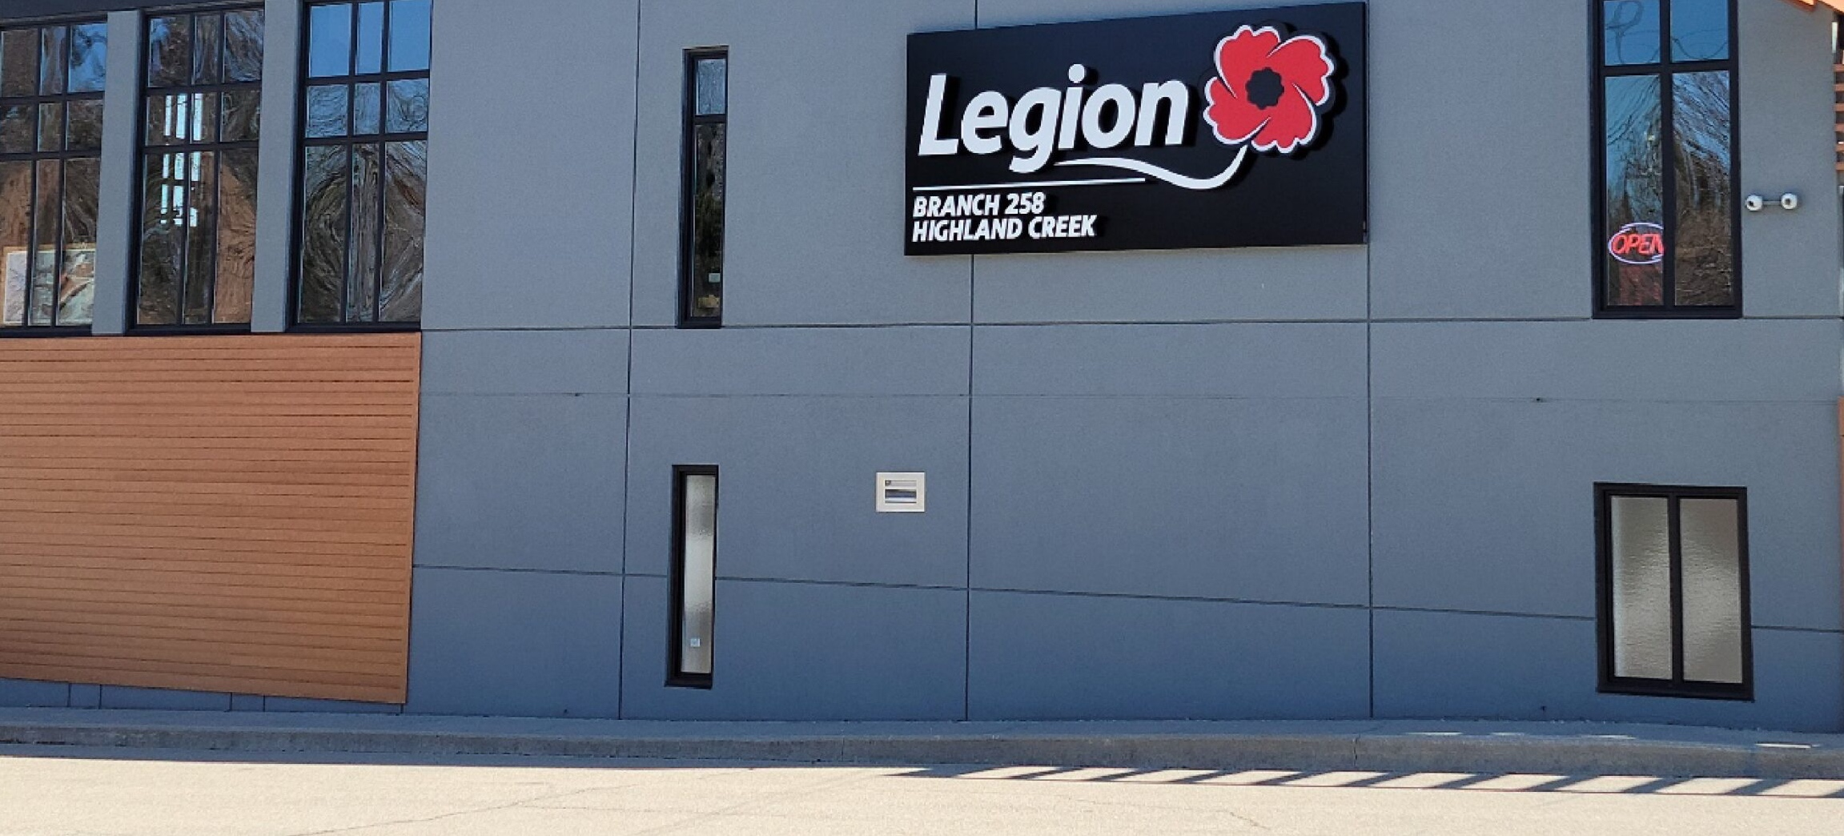

Ideas taking shape, more to come Expect to welcome many new members! Once in a lifetime opportunity
Notes:
In summary, ideas are still being considered, and more information and updates will be shared when possible.
We will still get updates through the monthly Legion Dispatch and through emails with Centenary tools and preparations.
Branch information packages will contain everything you need to help celebrate our 100th – from images, to ideas, to media tools.
We fully expect to welcome many new members during the Legion’s Centenary year, so that’s exciting, and we need to start planning! Again, we will receive tools and assistance at the Branch level.
This is a once-in-a-lifetime opportunity and a special time to be part of the Legion.
Let’s all celebrate and educate together!

Slide 10
The Royal Canadian Legion Centenary
A time to celebrate and educate!

